Slide 1

Student Performance Analytics
DSDE Project – Team 2
https://github.com/Team2-DSE

Slide 2




Team Working on this
Amjad Ali
Data Engineer
Dwarakanath Reddy
Data Scientist
Madhavi Kancham
Machine Learning Engineer
Imran Mohammad
Dashboard Developer /
BI Analyst
Designing and implementing data pipelines for ingesting, cleaning, and transforming student performance data.
Building descriptive and predictive models to identify factors influencing academic success and student outcomes.
Developing and implementing machine learning algorithms and models to address specific use cases, such as predicting student outcomes or identifying at-risk students.
Designing and developing Jupyter Notebook Visualizations and reports to visualize key performance metrics and insights derived from student performance data.

Slide 3

Project Goals
1
Analyze student performance, attendance, and engagement metrics.
2
Identify patterns, trends, and predictors of academic success.
Provide actionable insights for educators to tailor interventions and support
strategies.
3
4
Improve student retention and graduation rates through data-driven
decision-making.

Slide 4
Data
Student Information
Grades and Academic Performance
Essential data encompassing personal details, academic enrollment, and demographic information to profile students.
Crucial metrics comprising course grades, cumulative GPA, and academic standing to assess academic performance.
Attendance Data
Engagement Metrics
Core indicators covering participation, interaction, and communication, also extracurriculars like sports.
Insights into student attendance patterns and trends.

Slide 5
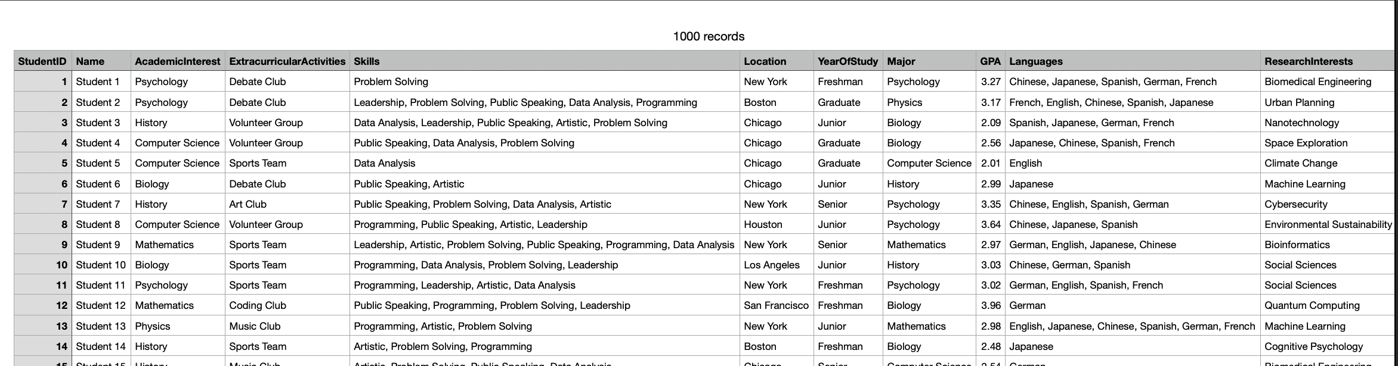
Name: Student # => Full Name
Data Preprocessing
Skills => Skill1, Skill2, Skill3, Skill4, Skill5
Languages => Lang1, Lang2, Lang3, Lang4, Lang5
Add Attendance data

Slide 6

Attendance Criteria
If gpa = 3.81 to 4, attendance = 86% to 100%
If gpa = 3.61 to 3.80, attendance = 71 to 85%
If gpa = 3.41 to 3.60, attendance = 56 to 70%
If gpa = 3.21 to 3.40, attendance = 41 to 55%
If gpa = 3.01 to 3.20, attendance = 26 to 40%
If gpa < 3.00, academic detention
We created a new column ‘Attendance data’ based on the above criteria.
We randomly distributed the attendance percentage, which aligns with our University attendance rules.

Slide 7
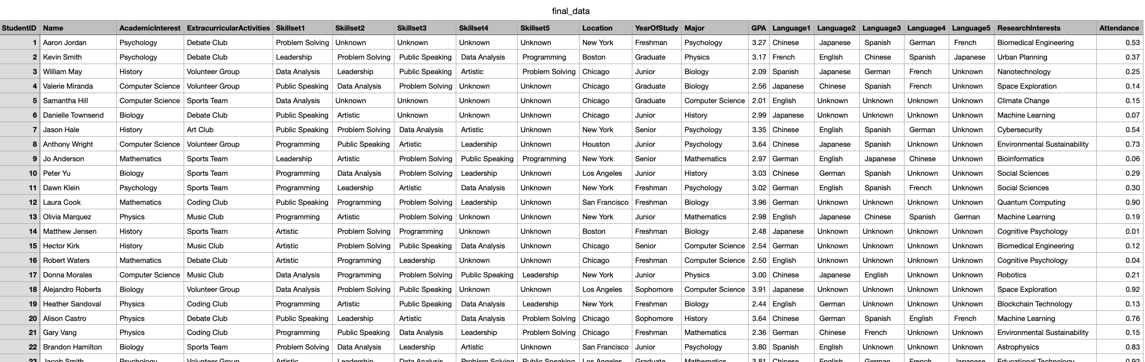
Student Information
Grades and
Attendance Data
Engagement Metrics
Academic Performance
Id, Name, Major, Location, Academic Interest, Year of Study
Extra-curriculars, Languages 1-5, Research Interest
Skillsets 1-5, GPA
Attendance Percentage

Slide 8

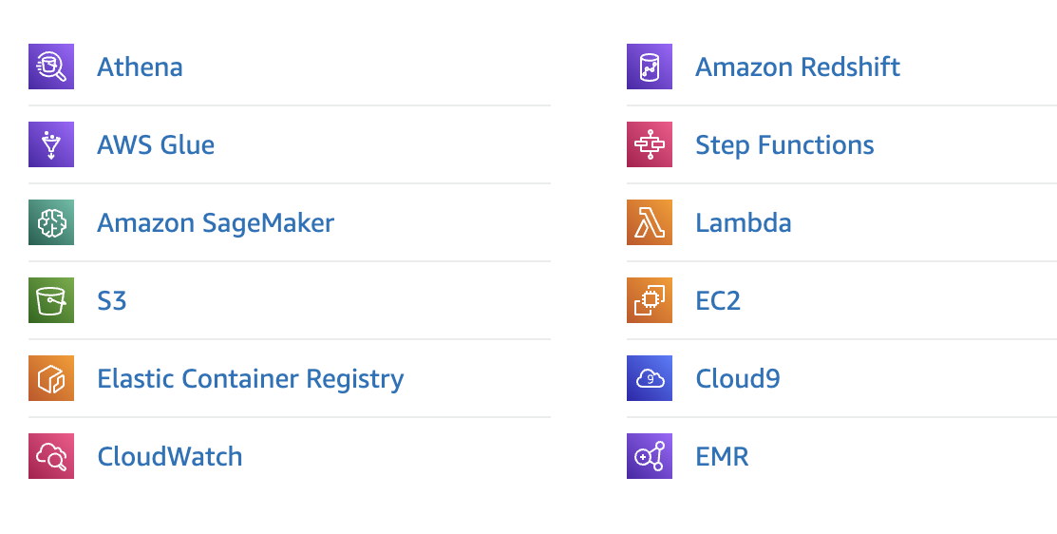
Data Engineering
Scalability: Highly Scalable
Flexibility: These services offer a wide range of tools and features
Integration: Designed to work seamlessly with each other.
Cost-effectiveness: Offer pay-as-you-go pricing model.
Managed services: AWS manages the infrastructure and maintenance of these services

Slide 9

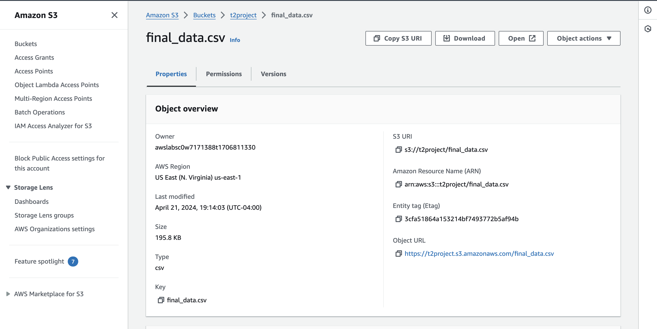
Source Data

Slide 10

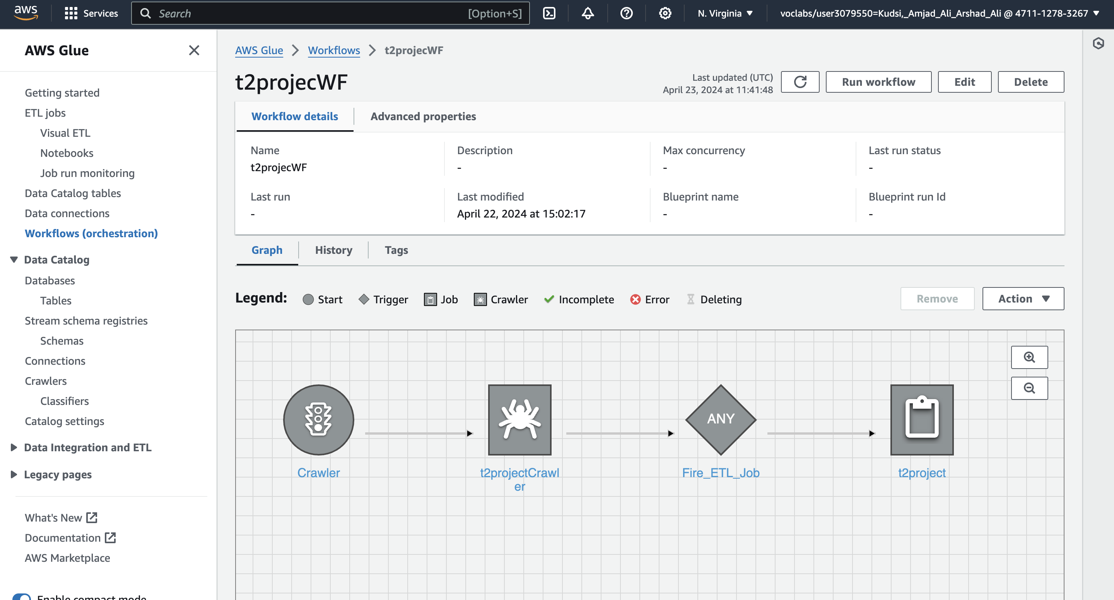
ETL Workflow

Slide 11
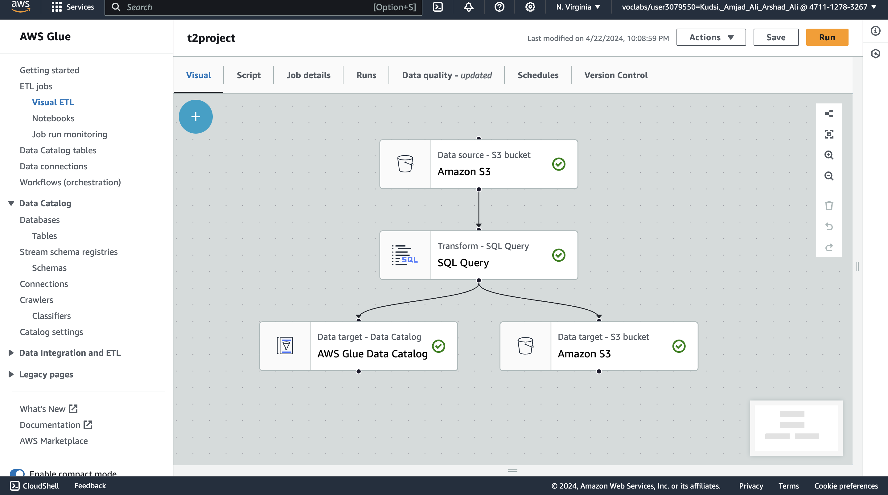
Visual ETL Job

Slide 12
Transformation logic
SELECT
*,
(CASE
WHEN Skillset1 <> 'Unknown' THEN 1 ELSE 0 END +
CASE
WHEN Skillset2 <> 'Unknown' THEN 1 ELSE 0 END +
CASE
WHEN Skillset3 <> 'Unknown' THEN 1 ELSE 0 END +
CASE
WHEN Skillset4 <> 'Unknown' THEN 1 ELSE 0 END +
CASE
WHEN Skillset5 <> 'Unknown' THEN 1 ELSE 0 END) AS SkillCount,
(CASE
WHEN Language1 <> 'Unknown' THEN 1 ELSE 0 END +
CASE
WHEN Language2 <> 'Unknown' THEN 1 ELSE 0 END +
CASE
WHEN Language3 <> 'Unknown' THEN 1 ELSE 0 END +
CASE
WHEN Language4 <> 'Unknown' THEN 1 ELSE 0 END +
CASE
WHEN Language5 <> 'Unknown' THEN 1 ELSE 0 END) AS LanguageCount,
(GPA + Attendance) / 2 AS CompositeScore
FROM
myDataSource;
New Columns:
SkillCount, LanguageCount and
Composite Score

Slide 13

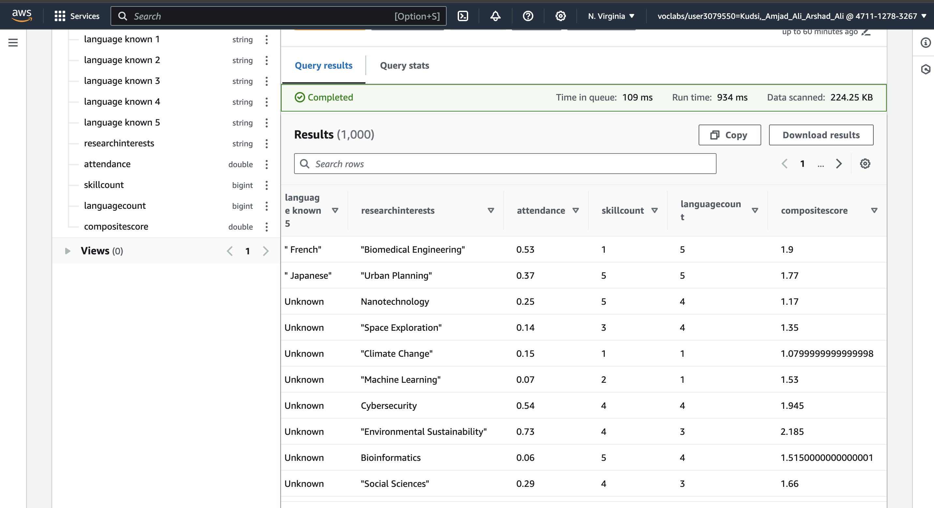
Visual ETL Job

Slide 14

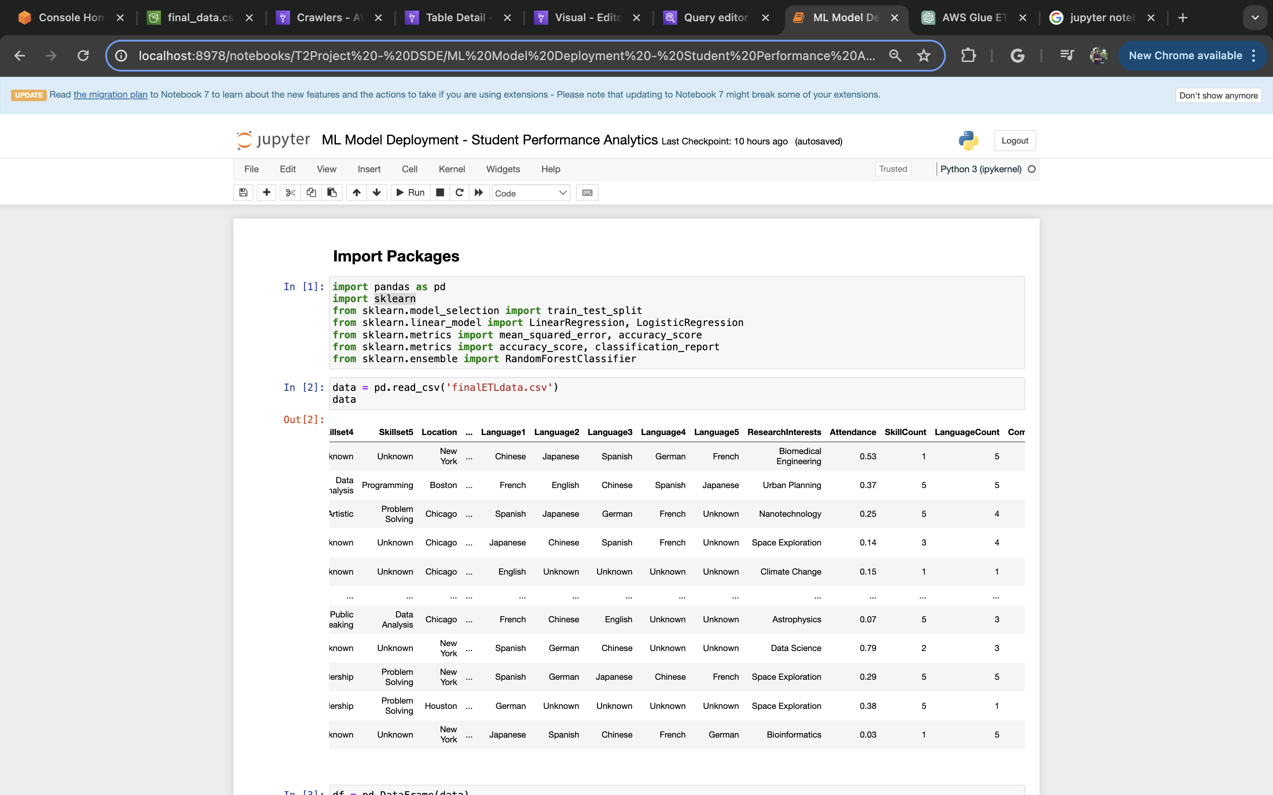
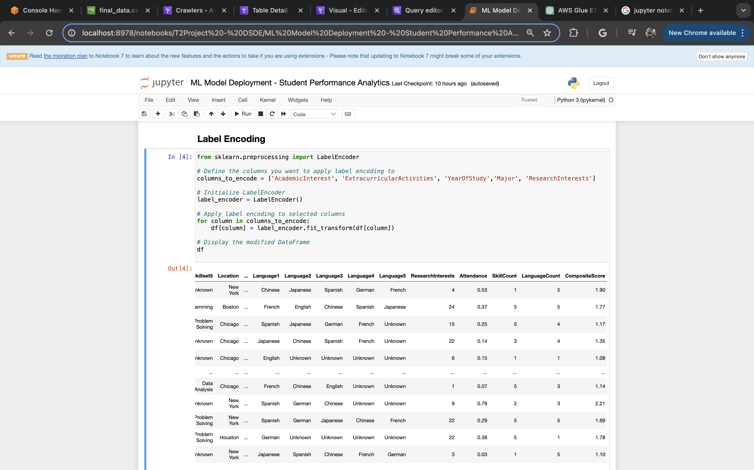
ML Model Deployment

Slide 15
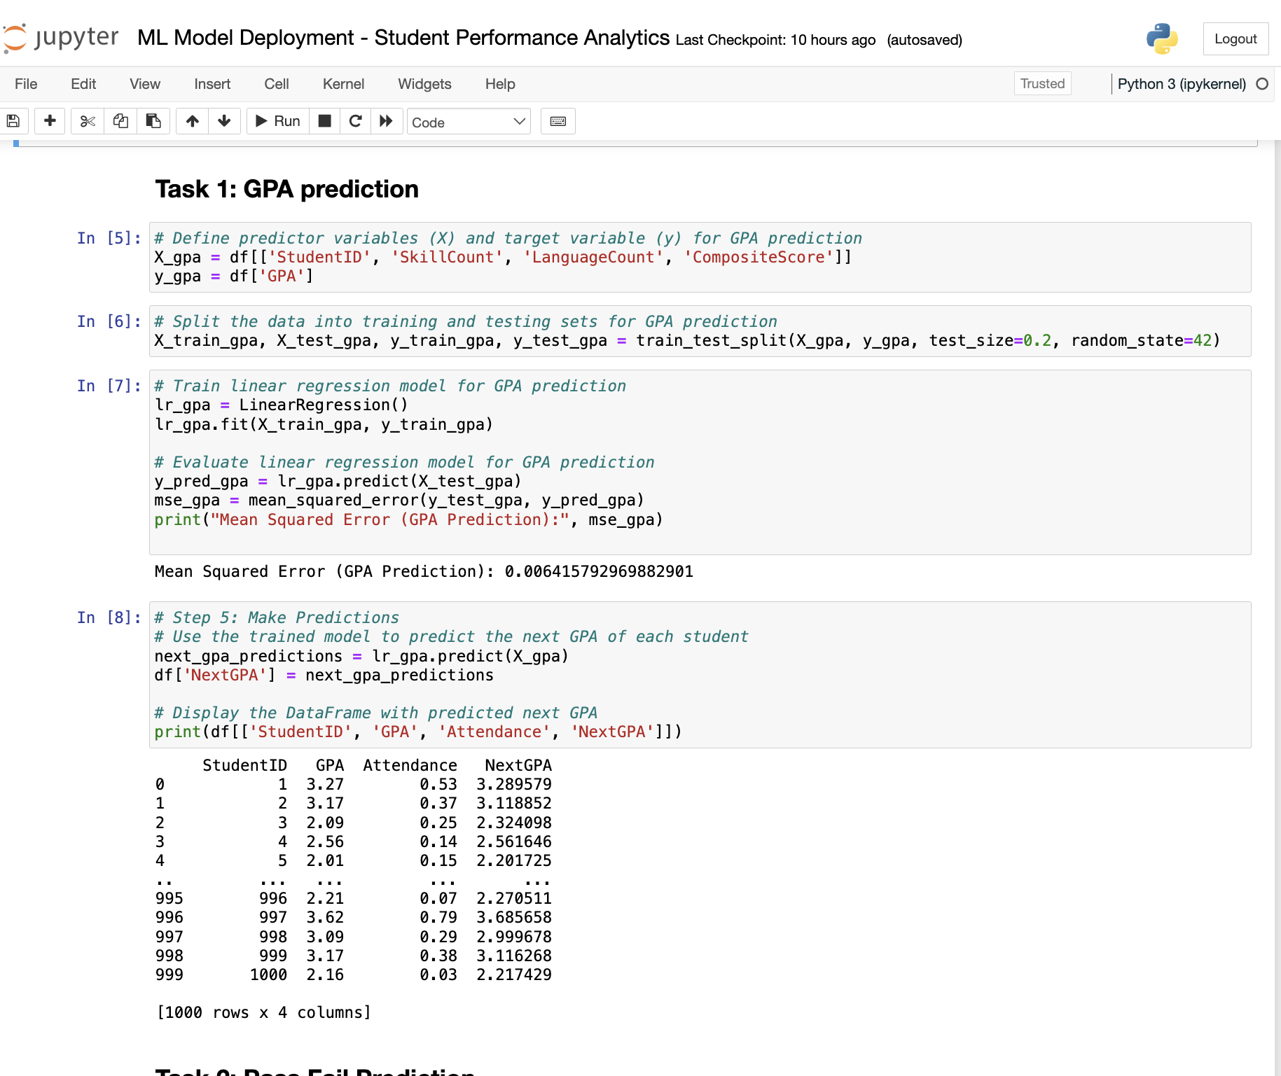
ML Model Deployment

Slide 16
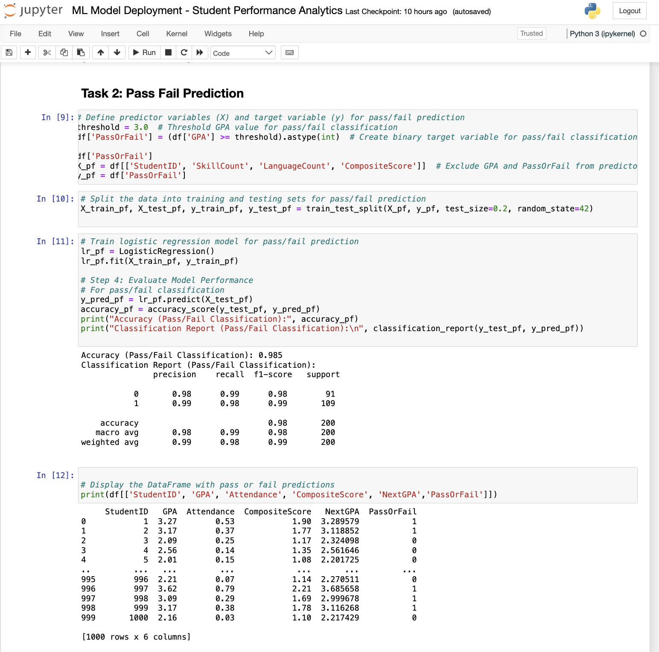
ML Model Deployment

Slide 17
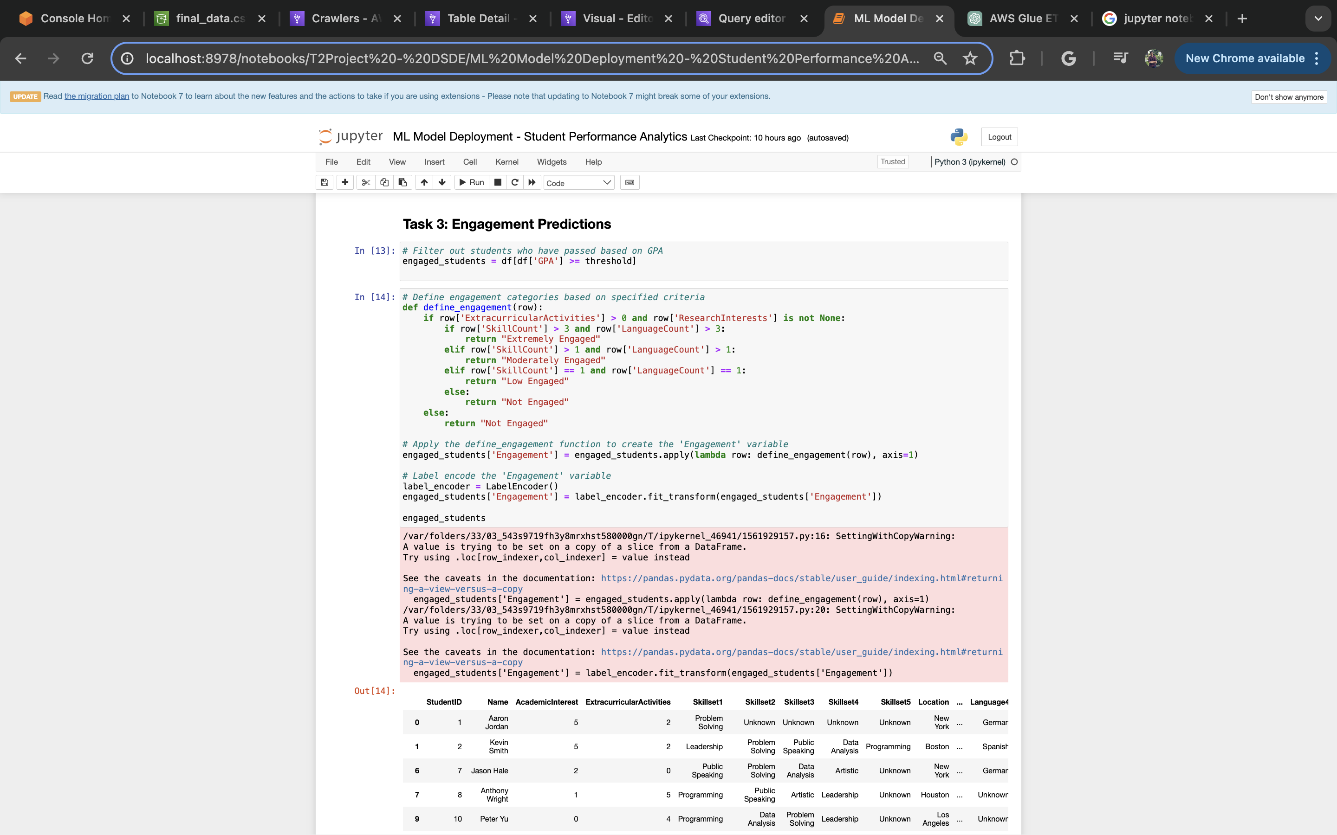
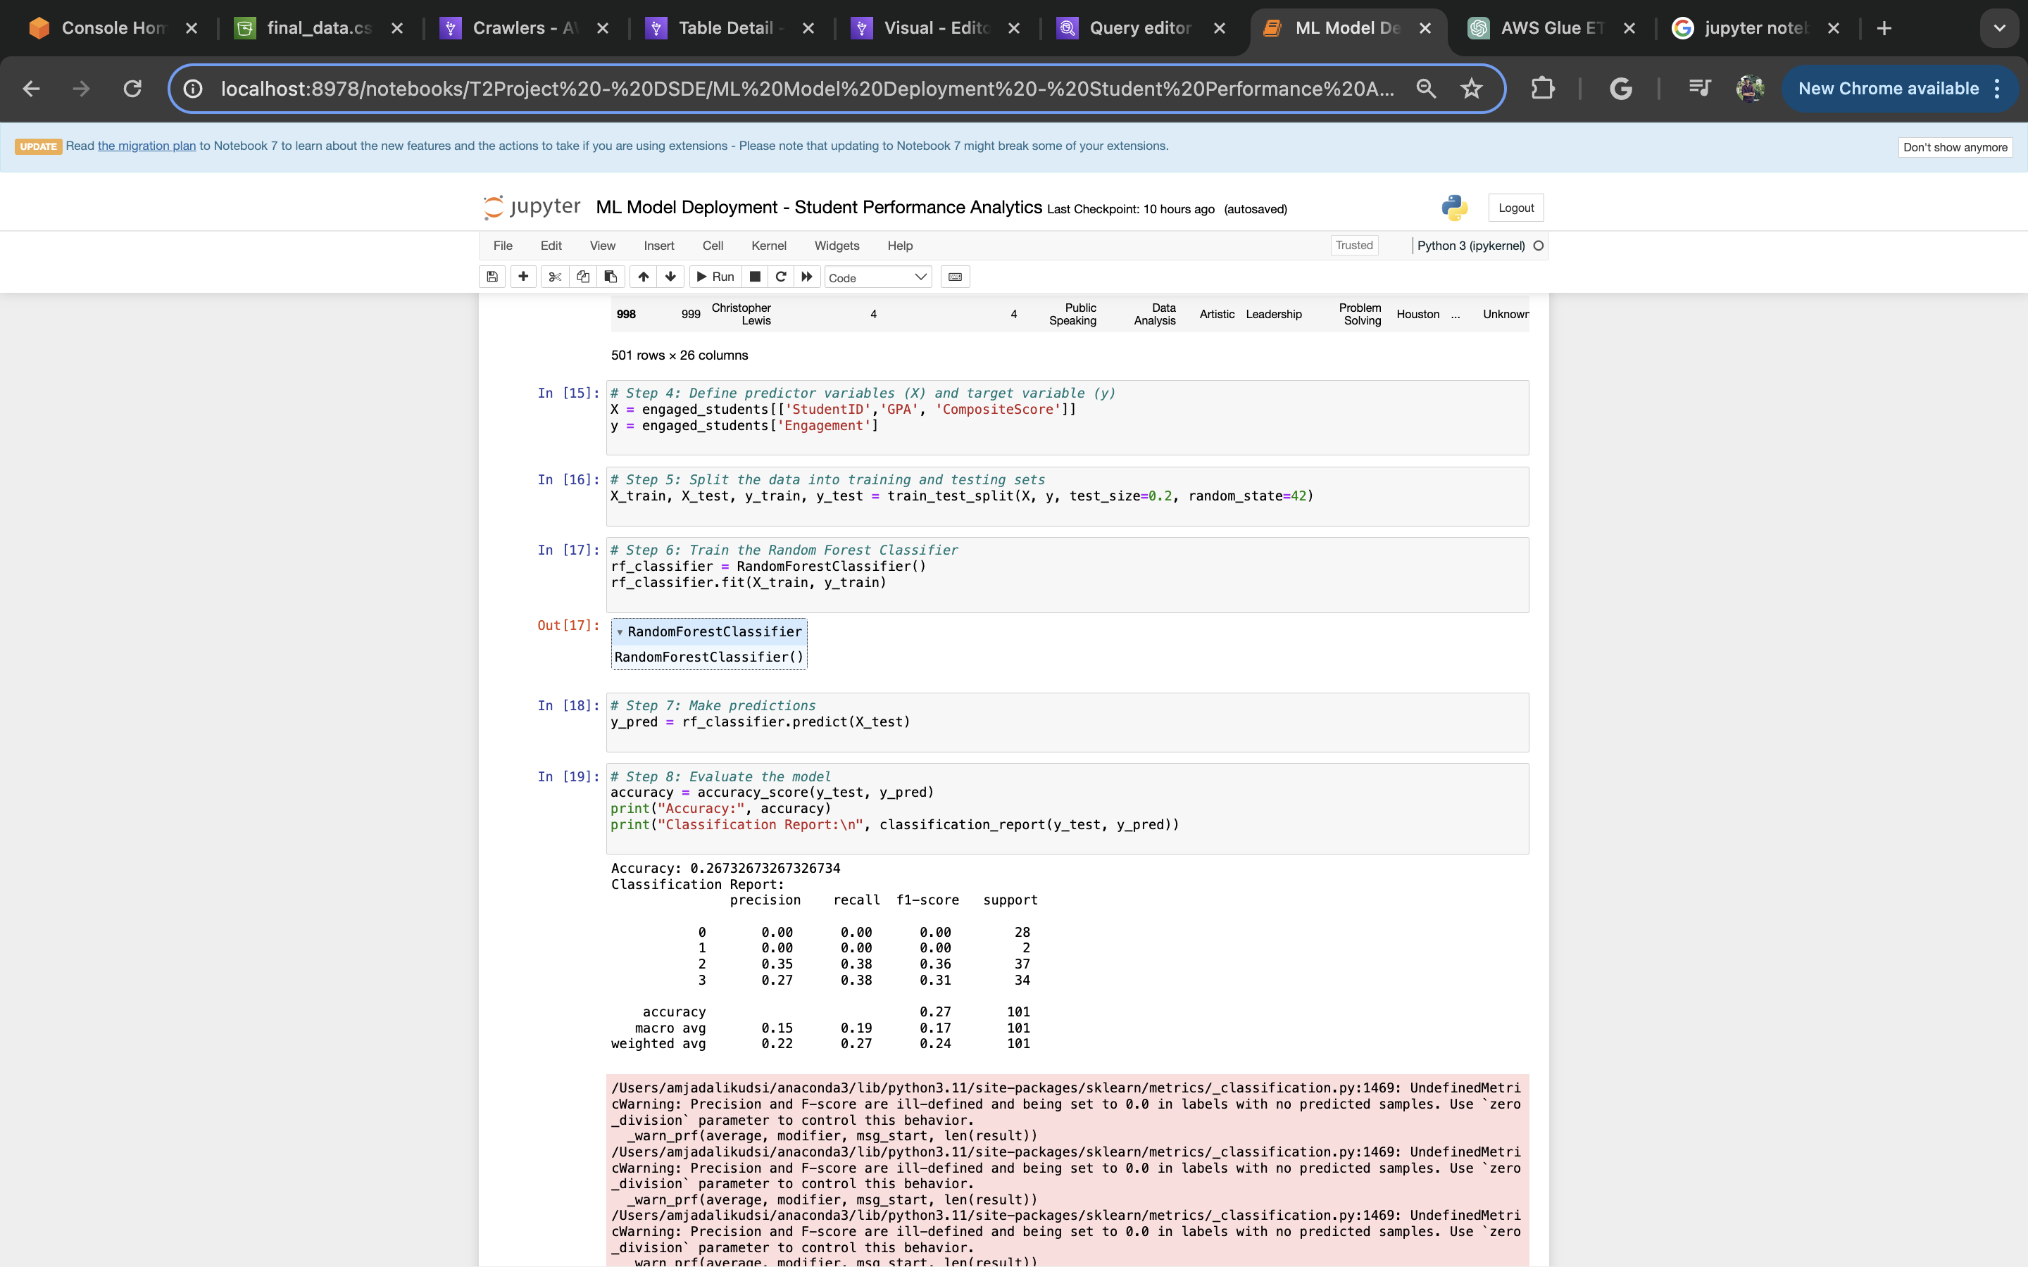
ML Model Deployment

Slide 18
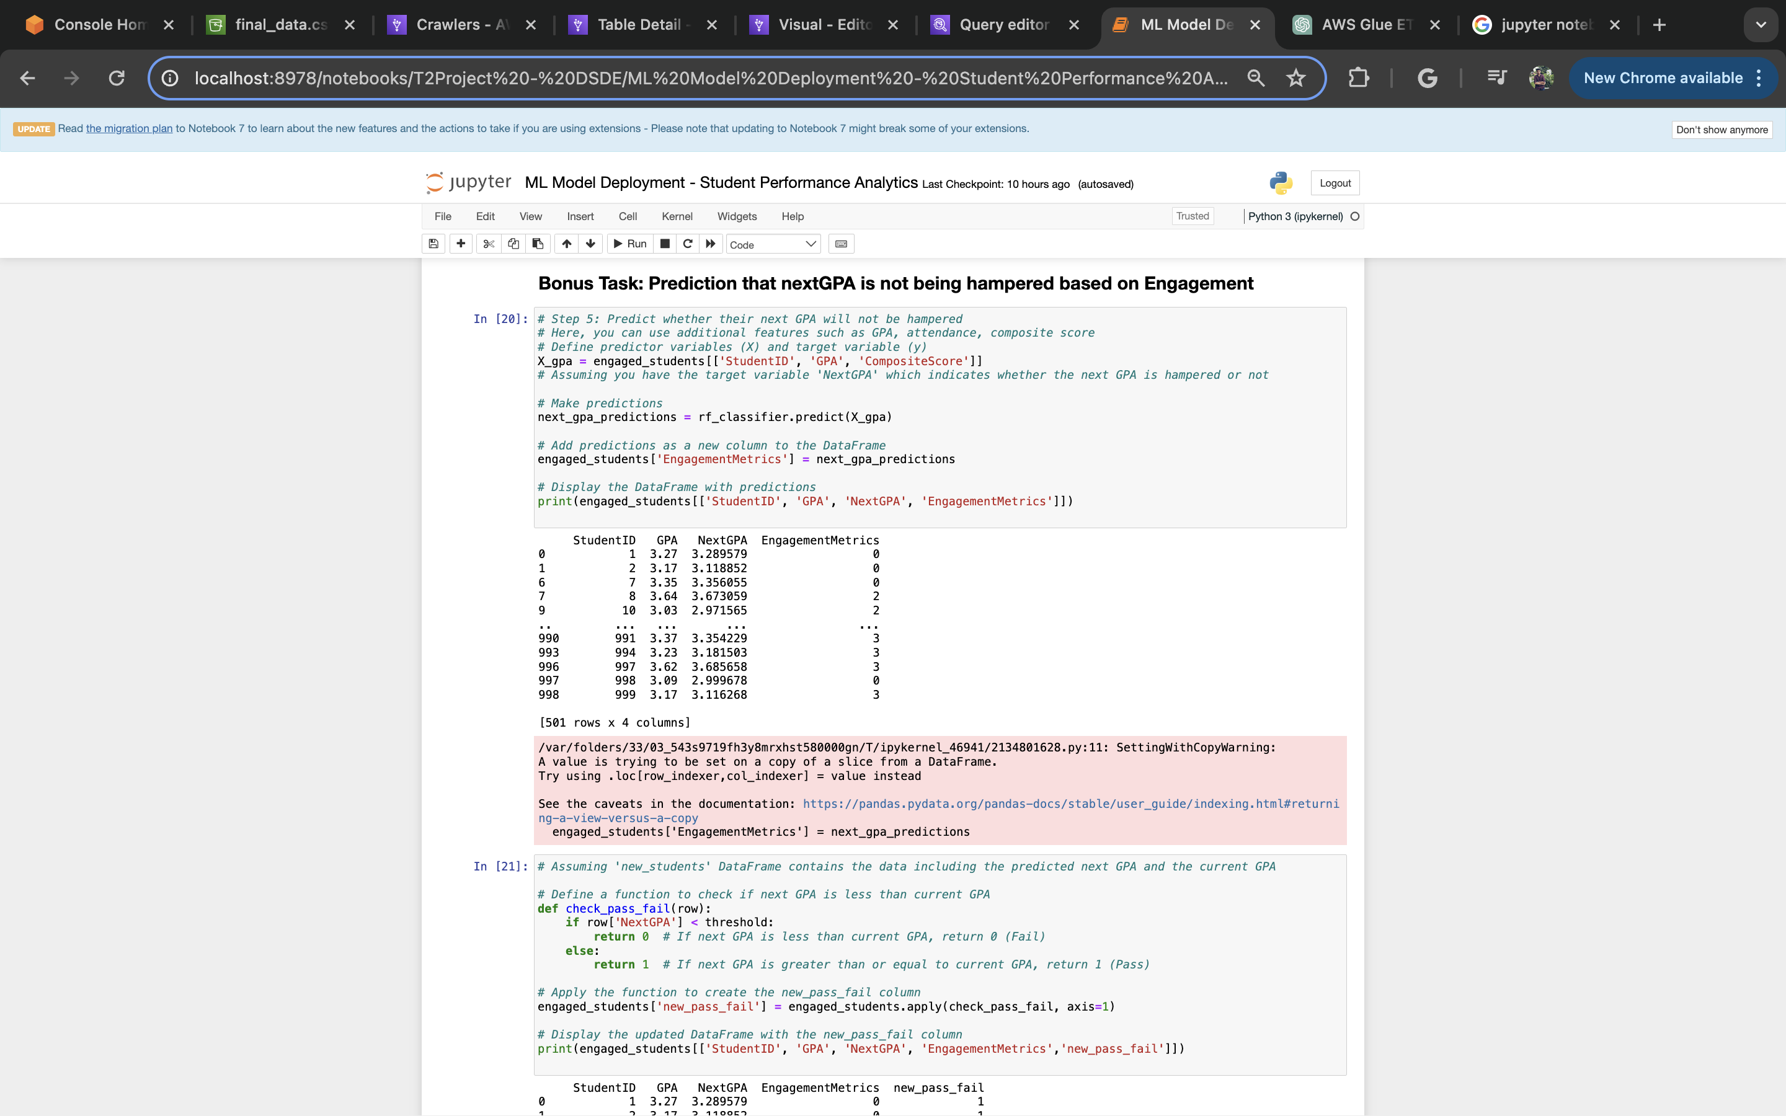
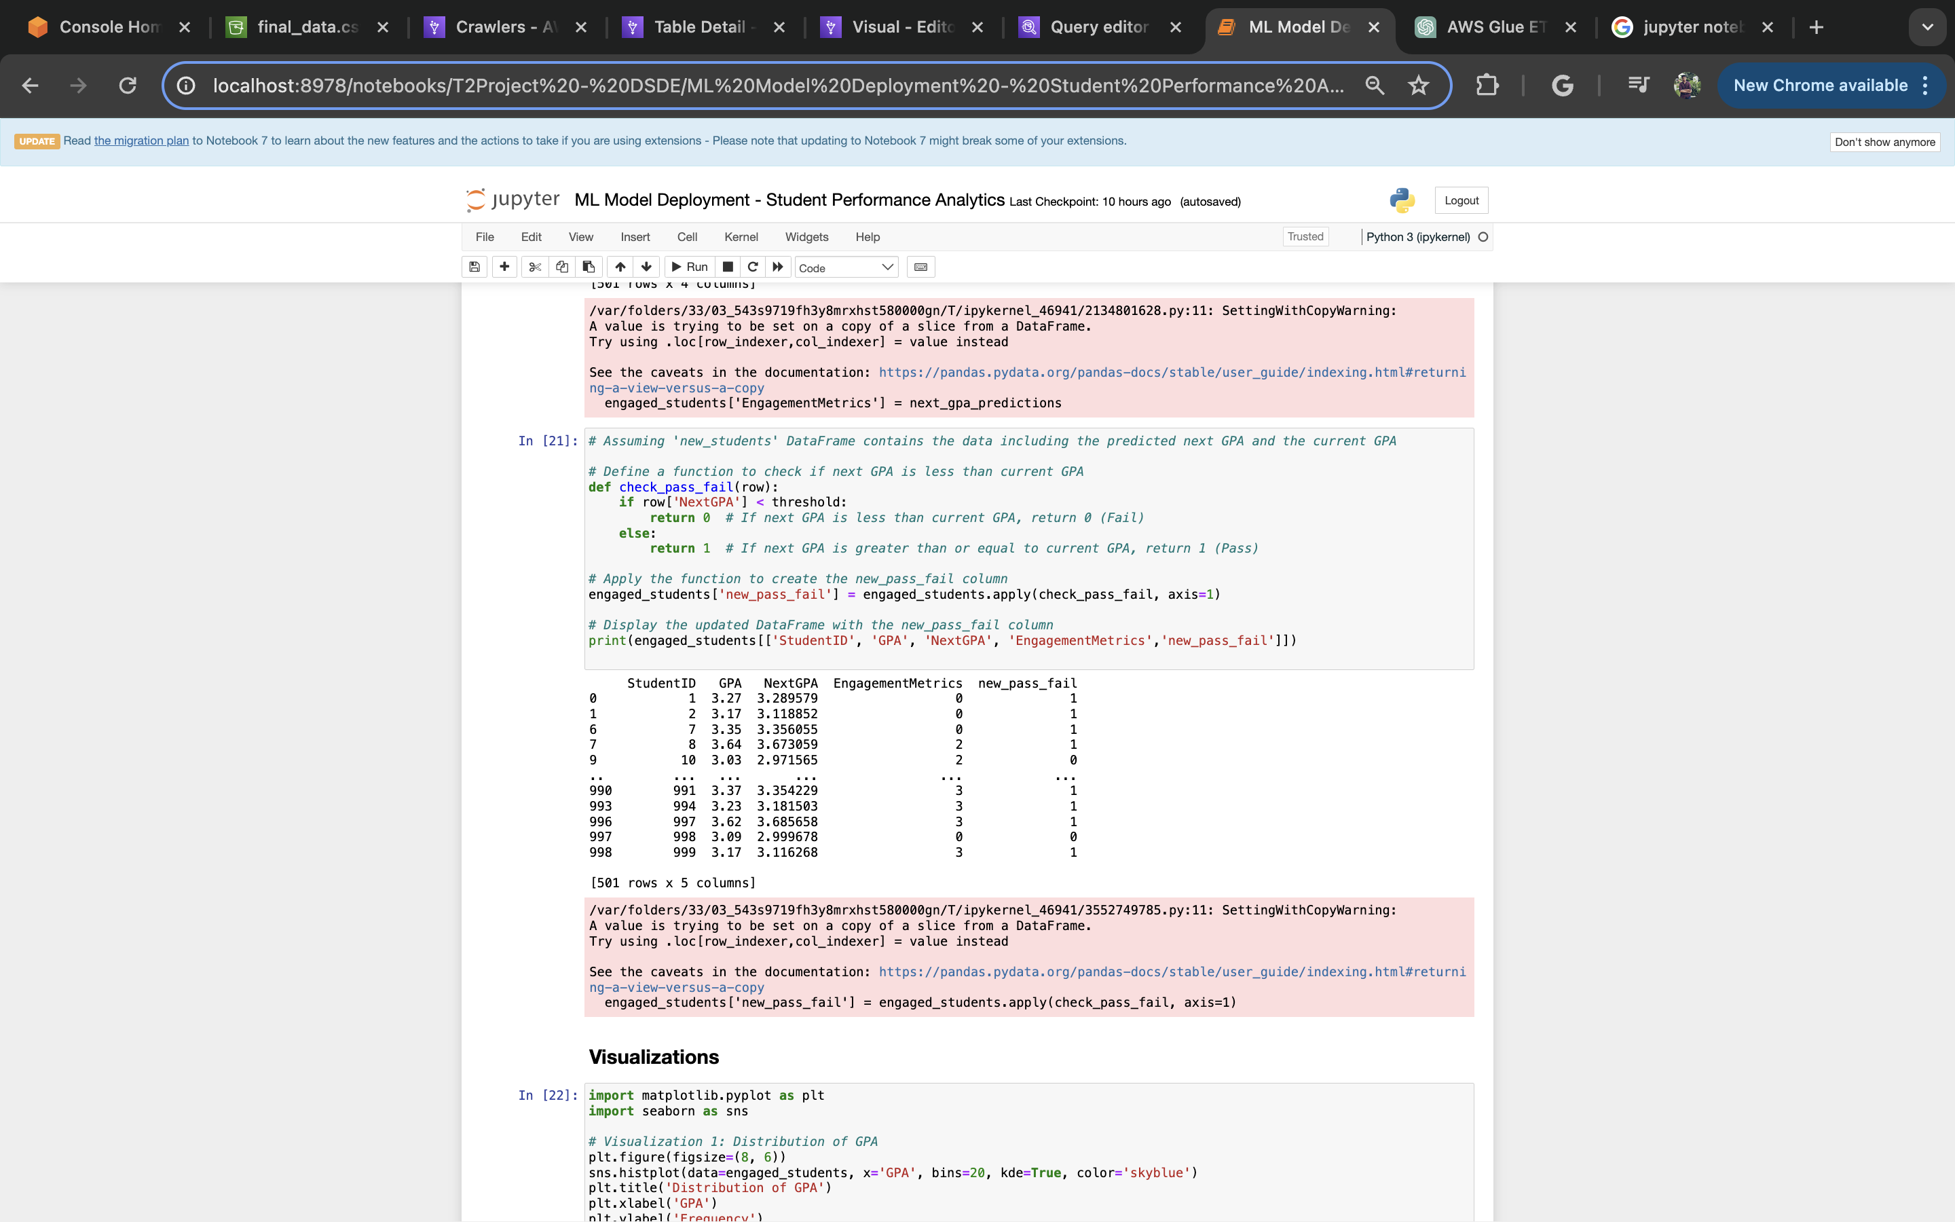
ML Model Deployment

Slide 19
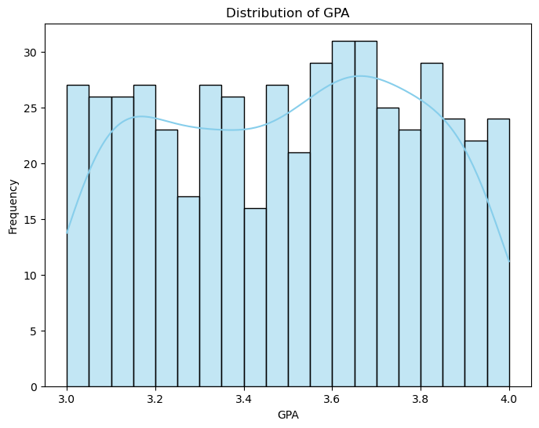
Visualizations
This is the GPA distribution across the entire dataset of only those students who passed I.e threshold >= 3.

Slide 20
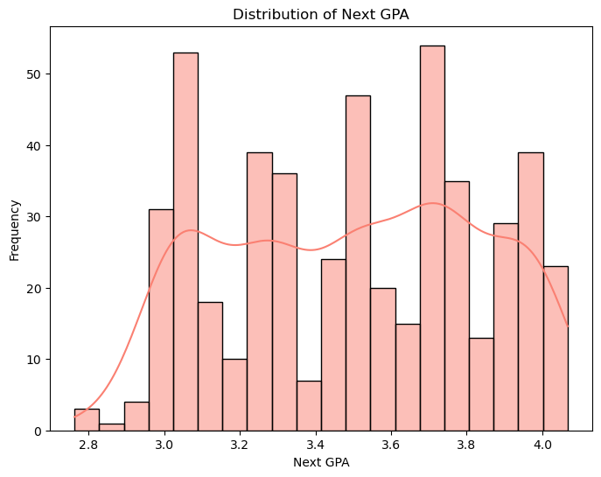
Visualizations
This is the distribution of the next Predicted GPA of all the students in the dataset based on the current GPA. The next GPA is calculated by taking the aggregate of GPA and attendance because GPA is directly correlated to attendance. We have seen that the higher the GPA, higher would be the attendance.

Slide 21
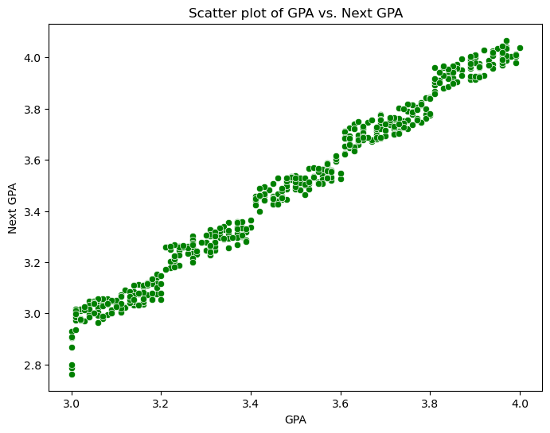
Visualizations
This is the comparison of gpa and next gpa of each of the students in the dataset. There are transitions where a student with more than 3.0 GPA gets a predicted nextgpa of less than 3.0 making that student in the fail status. We have also seen students failing currently and then passing in the next gpa. We think one of the major factors is Engagement because of which we have explained that in our analysis as well

Slide 22
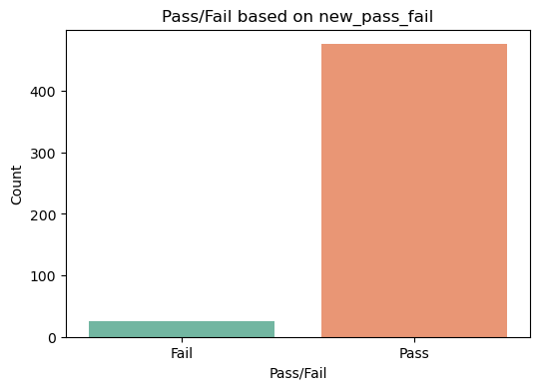
Visualizations
This is the new pass or fail sections after putting in the engagement metrics that changes our output analysis.

Slide 23
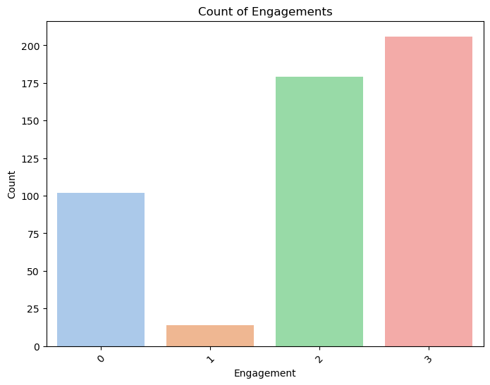
Visualizations
These are 4 categories ranging from 0 to 4 - No Engagement to Extreme Engagement. We have seen that students with extreme engagement tend to hamper their GPA scores as compared to the ones with no or low engagement.

Slide 24
Conclusions
Correlation between GPA and Attendance: Our analysis reveals a strong correlation between GPA and attendance, indicating that students with higher attendance tend to have higher GPAs. This underscores the importance of regular attendance in academic success.
Impact of Attendance on Next GPA: We observed that the next GPA can vary based on attendance records. Students who maintain consistent attendance may see marginal improvements in their next GPA, while those with irregular attendance may experience fluctuations, leading to lower or higher next GPAs.
Influence of Engagement Metrics on GPA: Engagement metrics, such as involvement in extracurricular activities and research interests, also play a significant role in determining GPA outcomes. Interestingly, students who are highly engaged in these activities may experience slight decreases in their next GPA, highlighting the potential trade-off between academic and extracurricular pursuits.
GPA Stability and Engagement Levels: Students with low engagement metrics (e.g., engagement level of 0) tend to exhibit more stable GPA trends, with minimal fluctuations in their next GPA. However, some students with relatively high GPAs (> 3) may experience unexpected declines in their next GPA, particularly when their engagement metrics are moderate (e.g., engagement level of 2).

Slide 25
Improving Student Success:
In light of our findings, universities can implement strategies to enhance student success:
Implement Attendance Monitoring Systems: Universities can deploy automated attendance tracking systems to encourage and monitor student attendance, thereby promoting academic accountability and improving GPA outcomes.
Enhance Engagement Opportunities: Universities should offer diverse extracurricular activities and research opportunities to foster student engagement. However, it's essential to strike a balance between academic and non-academic pursuits to ensure that student engagement positively impacts GPA outcomes.
Provide Academic Support Services: Offering academic support services such as tutoring, mentoring, and counseling can help students manage academic challenges and maintain satisfactory GPA levels.
Foster a Culture of Continuous Improvement: Universities should promote a culture of continuous improvement by regularly evaluating and refining existing programs and services based on student feedback and performance data.

Slide 26


Thank you

